Slide 1
Git
              -Jiban Krishna Dutta

Slide 2
Contents:-
What is Git ?
Why Git ?
Difference between Git and SVN ?
How to use them ?

Slide 3
Git :-
What is Git ?
Git is a distributed version control system (DVCS) for tracking changes in computer files and coordinating work on those files among multiple people.
Git is introduced by Linus Torvalds in 2005 for development of Linux kernel.
What type of file we can use with Git?
    Source Code
    Documentation
    Binary Files

Slide 4
Git :-
Why Git ?
Git is distributed
Speed :-
    Very fast operations compared to other Subversion
Everything is done off-line (except push and pull)
Space :-
    Compression can be done across repository not just per file.

Slide 5
Git :-
Difference between Git and SVN :-
When cloning is required for your repository by SVN we can only get current working copy, but in Git instead of getting just a working copy, Git receives a full copy of nearly all data that the server has.
For SVN your server must be connected with the system ,but for Git it is not necessary.

Slide 6
How to use Git
1.Installing Git for Linux :-
sudo apt-get install git
2.Configuring GitHub :-
git config --global user.name "user_name"
git config --global user.email "email_id"
3.Creating a local repository :-
git init My_Test
Initialized empty Git repository in /home/jiban/My_test/.git

Slide 7
Continued
4.Creating a README file to describe the repository
gedit README
5.Adding repository files to an index
git add sample.c
git add README
6. Committing changes made to the index.
git commit -m "some_message"

Slide 8
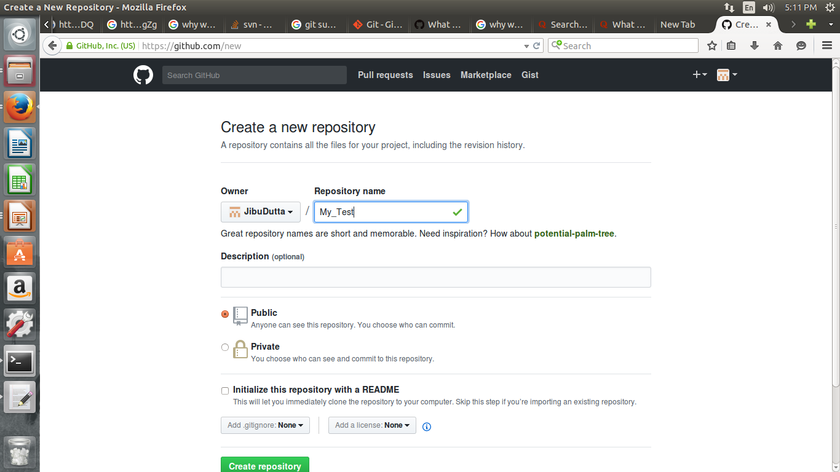
Continued. .

Slide 9
Continued . .
git remote add origin https://github.com/Jibu_Dutta/Mytest.git
7.Pushing files in local repository to GitHub repository
git push origin master
Give your (GitHub) username and password

Slide 10

Any Query :-

